Slide 1
OOP - Lesson 16 - Abstract Classes

Slide 2
What is an Abstract Class?
An abstract class is a class that does not get instantiated. Instead, it serves as a blueprint for other classes.
The way it serves as a blueprint is by being a base class.
The advantage: it forces you to write cleaner code.
For example, Animal would be an abstract class since you have no need to make an instance of Animal. Class Horse and Rabbit would be concrete classes that inherit from the abstract Animal class. Animal class would define an abstract method called feed(). That will force all the derived classes to define their own feed() method.
Another example is the Person class that you coded in your CampAssignment. Person class did not need a concrete implementation so that would be great for an abstract class. Camper class and Counselor class would still be the derived classes and would be concrete.

Slide 3
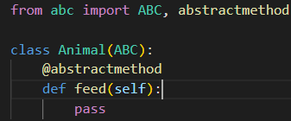
Syntax - Abstract Classes
The way to define an abstract class is by inheriting from ABC (Abstract Base Class):
The way to define an abstract method is by using the @abstractmethod decorator.
Notice that the method does not have a body, it just says “pass”
Any class that inherits from Animal is now forced to implement a feed() method. If it does not, the code will raise an error

Slide 4
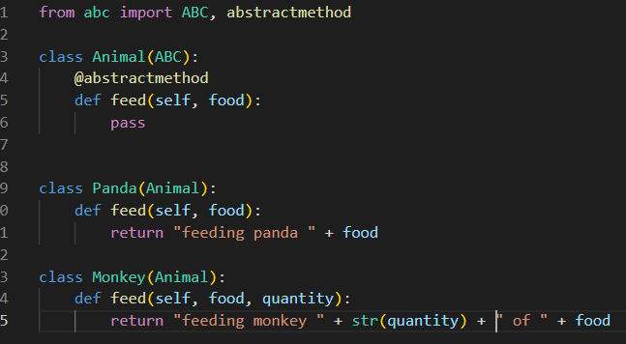
Syntax - Abstract method parameters
If the abstract class has parameters in the abstract method, the derived classes must have those parameters in the method as well
The derived classes can also add other parameters if it wants to

Slide 5
Non-abstract members of Abstract Class
An abstract class can also define a method that is not abstract if the functionality can be shared across all of its derived classes. For example, Animal class can define a sleep() method with a body, since the body of that method does not change between different types of Animals. (Where are my zookeepers??)
Such a method would work like a regular Base class’s method. Meaning, if you would call my_monkey.sleep(), it would hit the method of the Animal class.

Slide 6
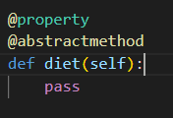
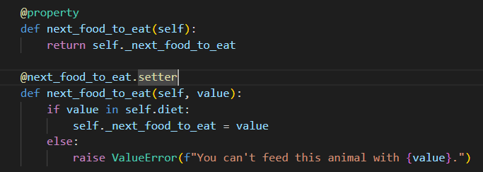
Syntax - Abstract Properties
You can define an abstract property by using both the @property decorator and the @abstract method decorator
Our animals will each need to define a concrete diet property which will store a list of allowed foods.
Then we can implement a concrete property (getter and setter) in the Animal class (which is an abstract class) called next food to eat. Before setting its value, it will check the diet of the Animal (which will step into the concrete class’s diet property) and check that the value passed in to the next food to eat is allowed.

Slide 7
Assignment
Develop a payroll program for a company. The company has two groups of employees: salaried employees and hourly employees. The salaried employees get a fixed weekly salary while the hourly employees get paid by hourly wages per week. The payroll program needs to display employee names and their monthly earnings (salaries).
Instructions:
Write an abstract Employee class and 2 concrete classes for HourlyEmployee and Salariedemployee
Employee constructor should accept 2 parameters: firstname and lastname. Assign them to attributes
Employee should define a concrete property for full_name.
Employee should define an abstract method for get salary
HourlyEmployee should accept 2 parameters in addition to the parameters that it needs for the base class. The 2 additional parameters are hourly_rate and hours_worked_this_week. Assign them to attributes.
HourlyEmployee should define a concrete version of the get_salary method which will calculate the salary based on hourly_rate and hours_worked_this_week
Salaried_Employee’s constructor should accept 1 parameter in addition to the 2 required for the base class. The additional parameter is weekly_salary. Assign it to an attribute.
SalariedEmployee should define a concrete version of get_salary() using the weekly_salary attribute.
Main:
Instantiate 5 different employees (of a mixture of both type) Add all the employees to a list of Employee.
Loop through the list of employees and display their full names and their salaries for the week. For a review of today’s lesson, see: https://blog.teclado.com/python-abc-abstract-base-classes/

